Slide 1
Online Linear Models for Edge Computing
${Hadar Sivan}^{1}$, ${Moshe Gabel}^{2}$ and ${\text{Assaf} \text{Schuster}}^{1}$
${1 \atop }$Technion ̶ Israel Institute of Technology, ${2 \atop }$University of Toronto
Notes:
Hello, my name is Hadar and I am presenting out work on Online Linear Models for Edge Computing setting with my advisors Moshe Gable and Assaf Schuster.

Slide 2
Setting
Update the model
Can offload some model computations to the cloud
Infinite stream of (occasionally) labeled samples
CPU or battery limited device
Data distribution changes over time,
requiring that we maintain an accurate model
Trained model
Notes:
In this example we can see a smart watch that gathers information about the user.
For example, it checks the heart rate and other parameters (for example number of steps per minute), and gets one sample with all this information every second.
It uses machine learning algorithm to learn a model from the data, that is then used by the device to inform the user on thing like unusual heart rate.
The data distribution changes over time, for example due to drift in one of the device's sensors.
Therefore, in order to maintain an accurate model, a frequent model computations are needed.
We can offload some of the model computations to a cloud server, and eventually the trained model is returned to the devices that uses it.
Our work focuses on this setting.

Slide 3
Existing Approaches
Sliding window with batch learners
Incremental learners
SGD [for example, Read (2018)]
Concept drift detectors
DDM [Gama et al. 2004]
EDDM [Baena-García et al. 2006]
ADWIN [Bifet and Gavaldà 2007]
→ Computation of new model for every window update is too expensive.
→ Model update is based on one sample only.
Concept drift detector
→ Based on incremental learners.
Learn model after drift detected
Monitor
Learning algorithm
Trained model
Output
Notes:
There are existing approaches for learning over data streams with concept drift.
Sliding window: for every new sample the window is updated – the new sample is added and the oldest sample is removed – and batch learner learns a model from the samples in the window. This is very simple but if the model is recomputed for every update of the window it could be very power consuming. Therefore the algorithm uses period parameter that controls the number of new samples between two model computations.
Incremental learners: those algorithms perform local update to the model with every new sample -- for example taking SGD step for every new sample. These algorithms can do all the model updates on the device itself because the computation is not heavy. One of the limitations of incremental algorithms is that they only see one sample at a time as opposed to batch learners that can see a larger picture.
Concept drift detectors are algorithms that use a base learner to learn a model and then use this model for prediction of new samples. They monitor the model output for new samples to detect a concept drift. EDDM for example, monitors the average number of samples between two errors of the model. If suddenly this number decreases significantly then EDDM considers it as concept drift.
We found that in practice most of the implementations of the concept drift detector use incremental base learners, rather then batch learners.

Slide 4
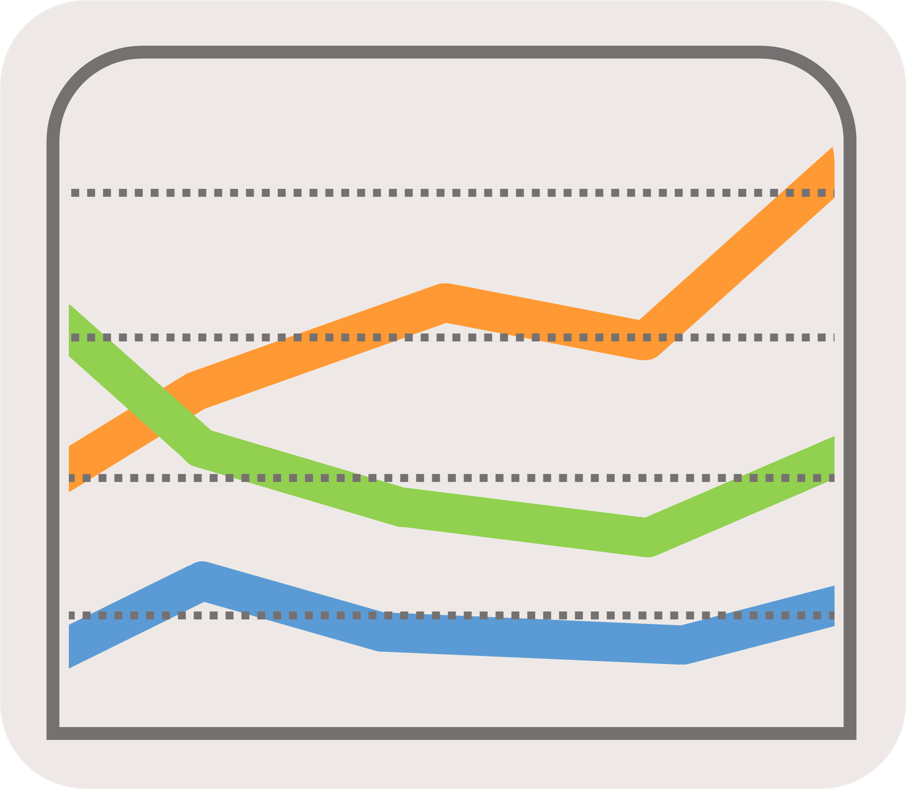
Motivation
Tradeoff between model accuracy and the number of model computations
(Model computations cost network, CPU or battery)
Notes:
We observe that the point of all these algorithms is to tradeoff between model accuracy and the number of model computations.
On one hand we want an accurate as possible model, and on the other hand we do not want to overwhelm the network (in case the model computation is done in a remote server) or CPU or battery.
Our work focuses on this tradeoff.

Slide 5
Our Contribution
DRUiD: Drift detectoR from boUnded Distance
Designed for remote batch learning in the cloud
Tradeoff batch model computations for better accuracy
Monitor the model coefficients rather than accuracy
Supports linear model with $L_{2}$-regularized convex differentiable loss
For classification and regression tasks
Notes:
DRUiD: Drift detectoR from boUnded Distance
Is a sliding window algorithm
And its main goal is to tradeoff a small number of batch model computations for better accuracy
Monitor the model coefficients rather than prediction accuracy
Suitable for any linear model with $L_{2}$-regularized convex differentiable loss
Supports both classification and regression tasks

Slide 6
The Approach
Bound the distance between two batch computed models $\left\|β_{1}^{∗}−β_{2}^{∗}\right\|$, without computing $β_{2}^{∗}$.
Continuously monitoring the distance between the last batch-computed model and the hypothetical model that could be computed from the current position of the sliding window, using the bound.
Notes:
Create a bound for the distance between the models
Use the bound in the algorithm

Slide 7
DRUiD Example
…
$$β_{1}^{∗}$$
$$β_{2}^{∗}$$
$$β_{2}^{∗}$$
$$β_{2}^{∗}$$
$$β_{2}^{∗}$$
${\left\|β_{1}^{∗}−β_{2}^{∗}\right\|}_{bound}≤$ Threshold
time
Notes:
DRUiD monitors the Euclidean distance between two optimal models of two positions of the sliding window.
Assuming that we have an efficient method to bound this Euclidean distance between two optimal models. Old and new, without the need to explicitly compute the new model.
At a certain point in time the optimal model over the samples in W_1, called beta^*_1, is computed.
With every new sample that arrives the sliding window is updated and the distance between the models is monitored (efficiently).
As long as the distance is smaller that a threshold there is no change.
Once there is deviation from the threshold a new model is computed from the samples in the current window position.

Slide 8
Definitions
$W$ : the sliding window at time $t$
$f\left(x,β\right)=x^{T}β$ : linear function
$\text{𝓁}\text{(}∙\text{,}∙)$ : differentiable and convex function w.r.t the second argument
$β_{t}^{∗}=\arg{\min_{β∈ℝ^{d}}{C \sum_{i∈W}{\text{𝓁}\text{(}y_{i}\text{,}f\left(x_{i},β\right))+\frac{1}{2}}{\left\|β\right\|}^{2}}}$ , $C>0$
$∇{\text{𝓁}}_{i}\left(β^{∗}\right)≔∇{\left.\text{𝓁}\text{(}y_{i}\text{,}f\left(x_{i},β\right))\right|}_{β^{∗}}$
Examples:
Logistic Regression: $\log\left(1+\exp\left(−y_{i}x_{i}^{T}β\right)\right)$
$L_{2}$-SVM: ${\left(\max\left\{0, 1−y_{i}x_{i}^{T}β\right\}\right)}^{2}$
Squared Error: ${\left(y_{i}−x_{i}^{T}β\right)}^{2}$
Notes:
In order to introduce the bound we first need some formal definitions.
An example for common loss functions, that are convex, differentiable and use linear model.

Slide 9
Bound $\left\|β_{1}^{∗}−β_{2}^{∗}\right\|$ (Theorem 1)
…
$𝓡$=removed samples
$𝓐$=added samples
Let $∆g≔\sum_{i∈𝒜}{∇{\text{𝓁}}_{i}\left(β_{1}^{∗}\right)} −\sum_{i∈ℛ}{∇{\text{𝓁}}_{i}\left(β_{1}^{∗}\right)}$ .
Then $\left\|β_{1}^{∗}−β_{2}^{∗}\right\|≤2\left\|r\right\|$ ,
where $r=\frac{1}{2} \left(β_{1}^{∗}−\frac{C_{2}}{C_{1}}β_{1}^{∗}+C_{2}∆g\right)$ .
$$W_{1}$$
optimal solution $β_{1}^{∗}$
$$W_{2}$$
optimal solution $β_{2}^{∗}$
time
Okumura et al. 2015 provide the bounds for the prediction of $β_{2}^{∗}$ for a new sample.
Notes:
Let’s look at two different positions of the sliding window W_1 and W_2 and o the differences between them.
We mark with fancy R (for removed) the set of samples that are in W_1 but not in W_2,
And we mark with fancy A (for added) the set of samples that are in W_2 but not in W_1.
C_1 is the inverse regularization constant for the optimization problem over W_1 and C_2 is for the optimization problem over W_2.
In most cases C_1=C_2 – for example in all the 3 examples that we saw in the previous slide (LR, SVM, Ridge Regression).
A cases where there is no equation is Mean Square Error (MSE) with non fixed sized window. In this case C_1 and C_2 depend in the number of examples in each window, which is different.
Okumura et al. 2015 provide the bounds for the prediction of \beta_2^* for a new sample. Our proof for Theorem 1 is inspired from their proof.

Slide 10
Bound of Common Objective Functions
$\left\|β_{1}^{∗}−β_{2}^{∗}\right\|≤2\left\|r\right\|$, where $r=\frac{1}{2} \left(β_{1}^{∗}−\frac{C_{2}}{C_{1}}β_{1}^{∗}+C_{2}∆g\right)$
Model | Objective function | $$r$$
$L_{2}$-regularized LR | $$C \sum_{i}{\log\left(1+\exp\left(−y_{i}x_{i}^{T}β\right)\right)+\frac{1}{2}}{\left\|β\right\|}^{2}$$ | $$\frac{C}{2}∆g$$
$L_{2}$-regularized $L_{2}$-SVM | $$C \sum_{i}{{\left(\max\left\{0, 1−y_{i}x_{i}^{T}β\right\}\right)}^{2}+\frac{1}{2}}{\left\|β\right\|}^{2}$$ | $$\frac{C}{2}∆g$$
Ridge regression | $$\sum_{i}{{\left(y_{i}−x_{i}^{T}β\right)}^{2}+α}{\left\|β\right\|}^{2}$$ | $$\frac{1}{4α}∆g$$
Notes:
Note that the objective function of Ridge Regression is not in the canonic form, but by choosing C=0.5 alpha in the canonic form we get an equivalent optimization problem (they both have the same optimal solution).

Slide 11
DRUiD Algorithm
For every new labeled sample:
Update the sliding window $W$
Update $\left\|r\right\|$ using Theorem 1
If $\left\|r\right\|>Threshold$, compute $β_{1}^{∗}$ from the samples in $W$
Prediction for a new sample $x$:
Return the prediction of $β_{1}^{∗}$ for $x$
Notes:
When a new labeled sample arrives, DRUiD first update the sliding window by adding the new sample and removing the oldest sample.
It then update the norma of r using Theorem 1.
Eventually, it checks if r is bigger then some Adaptive Threshold.
If DRUiD observes that r is above the threshold for multiple samples in a row it drops the old model and re-computes a new model from the samples in the current window position.
DRUiD uses \beta^*_1 for the prediction of a new sample.

Slide 12
Adaptive Threshold
We model $\left\|r\right\|$ as a $χ_{d}$ distribution:
Collect some samples of $\left\|r\right\|$
Fit $χ_{d}$ distribution to collected $\left\|r\right\|$
Choose Threshold such that $Pr\left[ \left\|r\right\|≤Threshold \right]>α$
$$f\left(\left\|r\right\|\right)$$
$$α=0.95$$
$$Threshold$$
$$\left\|r\right\|$$
Notes:
This is how the Adaptive Threshold is determined.
We model norm r as a chi distribution with d degrees of freedom.
DRUiD evaluates the distribution parameters.
The full details are in the paper.
=====================================================
This is how the Adaptive Threshold is determined.
We model norm r as a chi distribution with d degrees of freedom, where d is the dimension of the samples in the stream
1+2 : After every new model computation DRUiD collects some samples of r and fits this collection a chi distribution.
Alpha is a user defined parameter that controls the sensitivity of the algorithm to concept drifts.
The adaptive threshold is automatically determined by the given alpha and the fitted distribution.
There is a small probability that a sample comes from the fitted chi distribution and gives norm r above the threshold (1-alpha).
Therefore, DRUiD considers this event as warning.
And as said in previous slide, after some consecutive warnings a new model is recomputed.
*The curve in the example (the y axis is the PDF=Probability density function)

Slide 13
Experimental Results

Slide 14
Baselines
Sliding Window – different period
Incremental SGD
DDM – different sensitivity
EDDM – different sensitivity
ADWIN – different sensitivity
PredSign (based on Okumura et al. 2015) – different sensitivity
Concept drift detectors
Notes:
The base learners for all the algorithms are:
Batch solver for L2-Reg logistic regression
Incremental SGD for L2-Reg logistic regression
As said before, Sliding Window and Incremental SGD performs implicit adaptation to concept drift.
DDM,EDDM,ADWIN where run with the two base learners – batch and incremental.
PredSign: based on Okumura et al. that bounds the prediction of the new model.
We implemented this algorithm to compare DRUiD to existing bounds on model predictions.

Slide 15
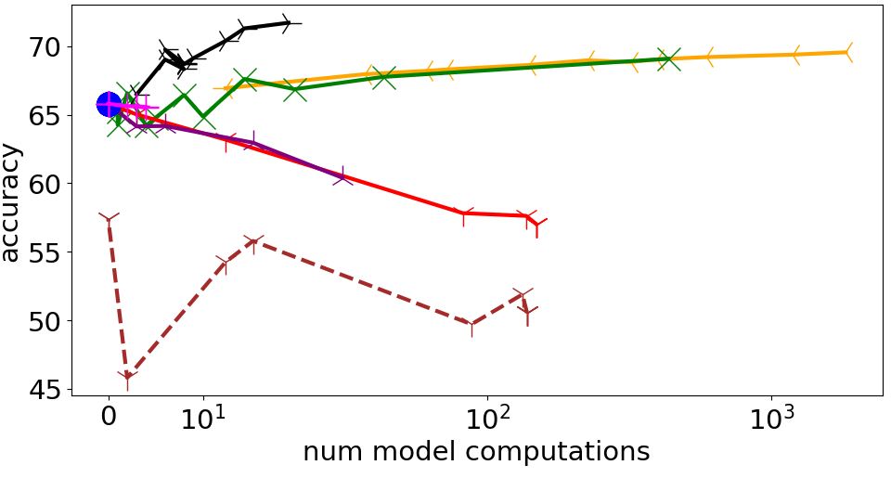
Electricity Pricing Dataset
Better tradeoff
Notes:
We started with a real-world dataset – the Electricity Pricing Dataset.
This dataset was collected from the Australian New South Wales Electricity Market (state on the east cost of Australia). In this market, prices are not fixed and are affected by demand and supply of the market.
The task is a classification task – to predict whether the electricity price is going up or down.
We measure the tradeoff between accuracy and number of model computations.
The closer a point in the graph is to the top left corner, the better the tradeoff is.
We tested every algorithm with range of sensitivity levels to concept drift.
We look at DDM with batch base learner as an example – we started with low sensitivity level and got 0 model computations and around 57% accuracy. Then we tested a range of sensitivity levels.
This is the tradeoff curve that illustrates the performance of DDM batch across a range of sensitivity levels.
And these are tradeoff curve for all the other algorithms.
We see that DRUiD gets the best tradeoff, as I mentioned before the upper-left corner is the best tradeoff because it means less model computation but with high model accuracy.
The batch version of DDM has poor performance and as I mentioned earlier, most implementations of DDM and EDDM are based on incremental learners.

Slide 16
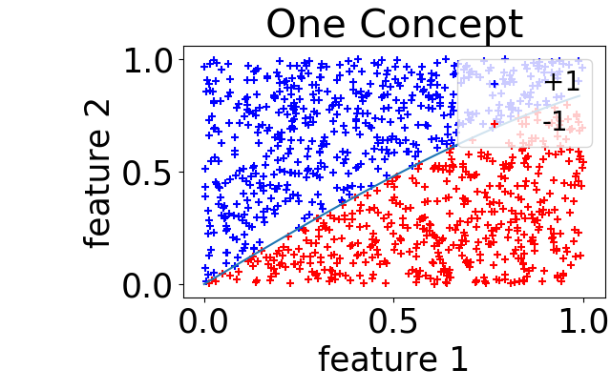
Sine1+
Stretch feature 1 by $σ$=4
Notes:
Sine1+ is based on Sine1 dataset, which is a synthetic dataset and commonly used for concept drift detectors evaluation.
We used the sigma parameter to stretch one of the features of sine1, which makes the problem more ill-conditioned.
The larger the sigma is, the more ill-conditioned the problem is.
We can see that the incremental algorithms have degradation in the performance when the problem is ill-conditioned.

Slide 17
Sine1+ (Cont.)
DRUiD’s batch mode computation performs well on ill-conditioned problems, while incremental algorithms perform poorly [Boyd et al., p. 467 (2004)].
Notes:
And this is consistant with the literature – we know it takes more time to algorithms based on GD to converge when the problem is ill-conditioned.
To confirm that we looked at the convergence rate of the algorithms and we see that it takes more time for the SGD based algorithms to converge after a concept drift, while DRUiD performs well because it is based on batch learner.
=============================================
In the lower graphs we can see the level sets of the objective function for the different sigma values. When the level sets are more narrow it indicates the problem is more ill-conditioned.

Slide 18
Additional Results
Regression
Cover Type
Sine1+ dimensionality
And more…

Slide 19
Conclusions
We bound the difference between coefficients of two models, $\left\|β_{1}^{∗}−β_{2}^{∗}\right\|$.
Base on this bound, we provide DRUiD, which provides good tradeoff between model accuracy and number of model computations.
Future work - bound for non linear problems.
Notes:
Thanks you very much for listening.
Are there any questions?

